Slide 1

ARDUINO – Day3
BIOE 3090
3/12/2020

Slide 2

Activity 5 – Blink_3090 – no delay
Using
currentTime
lastTime
switchTime
ledState
Millis()
Create
Delay()-free timing in main loop
Blink LED

Slide 3
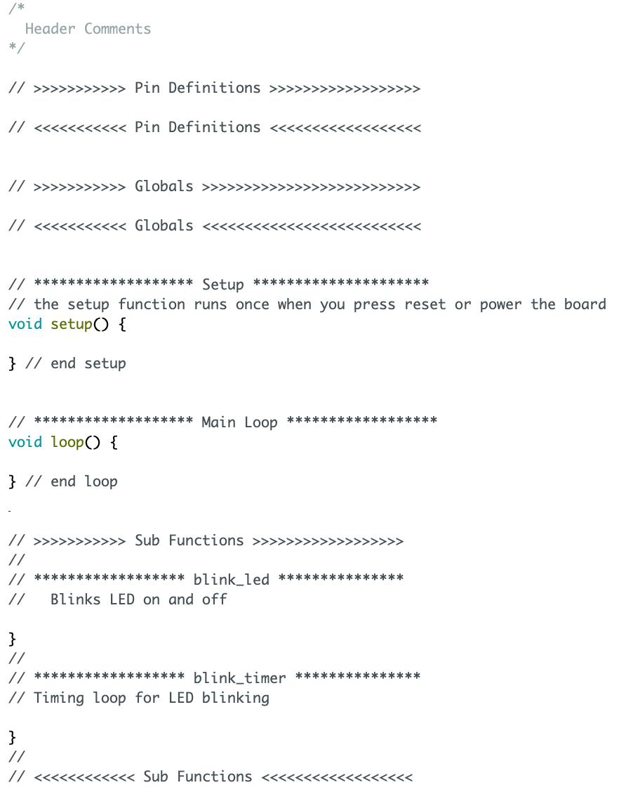
Begin
Pin Definitions
Setup
Loop
Blink_timer()
N
If
Y
blink_led()
Elapsed Time > Switch Time

Slide 4
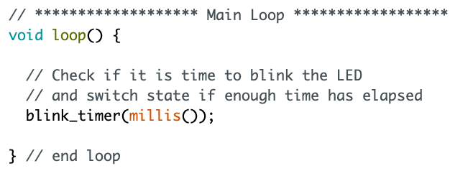
Main Loop
Timing function
Get the current
time & pass to function
blink_timer( millis() )

Slide 5
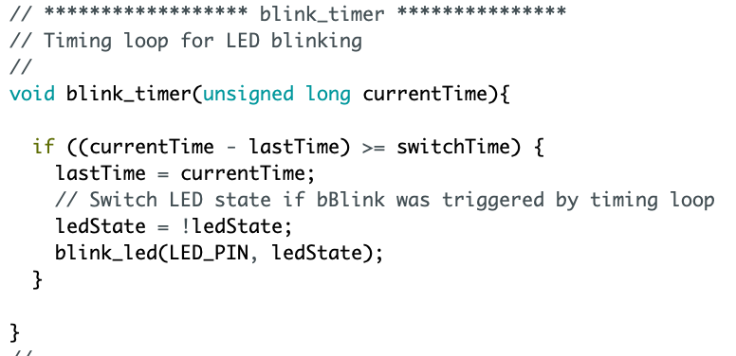
Main Loop
Check if it is time to
blink

Slide 6
Main Loop
Check if it is time to
blink
Flip Bool State

Slide 7

Main Loop
Important problem
here

Slide 8
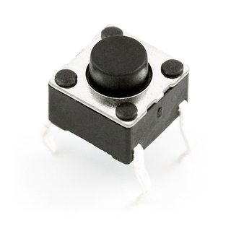

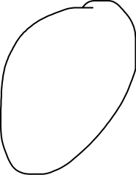

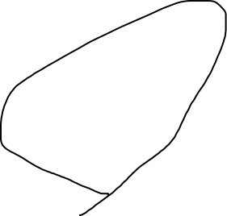

Pushbutton Input
I want a button that starts/stops the LED blinking!

Slide 9
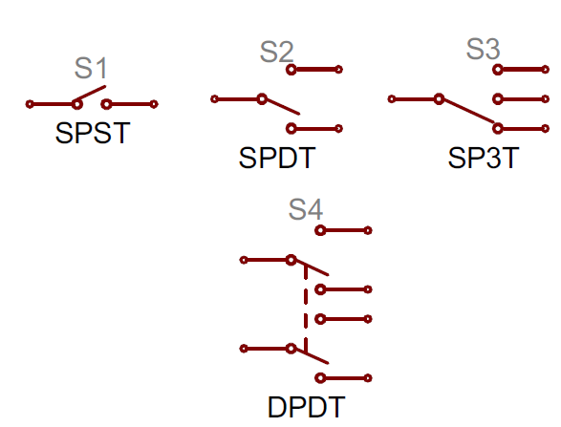
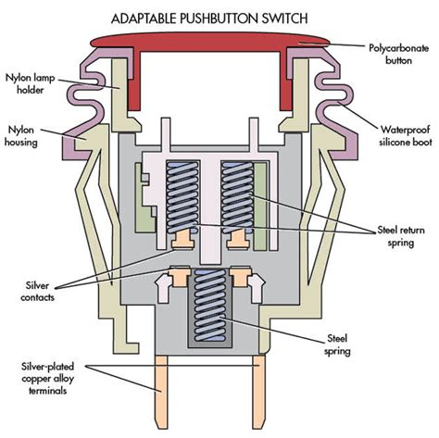
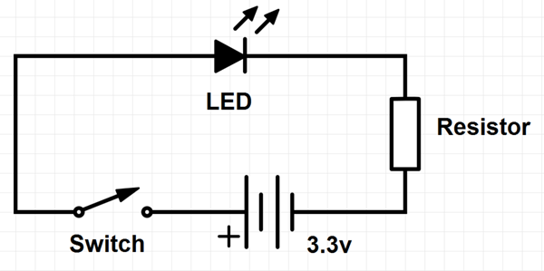


Anatomy of a Pushbutton

Slide 10
Polling – Easy, not great, button state detection
#define PB_PIN 12
pinMode(PB_PIN, INPUT);
bool pbLatch = false;

Slide 11
Activity 6 – Blink_3090 – Polling
Using
PB_PIN
pbLatch – hint: this stores button state
Create
Poll in main loop to latch on/off LED when button pressed
Hint: probably going to want an if statement
Now with Pushbutton Action!!!!

Slide 12
Program Flowchart - Polling
Begin
Loop
Pin Definitions
N
If
Y
pbLatch = false
pbLatch = true
Setup
Pushbutton pressed
Blink_timer()
N
If
Y
blink_led()
Elapsed Time > Switch Time
&& pbLatch == true

Slide 13
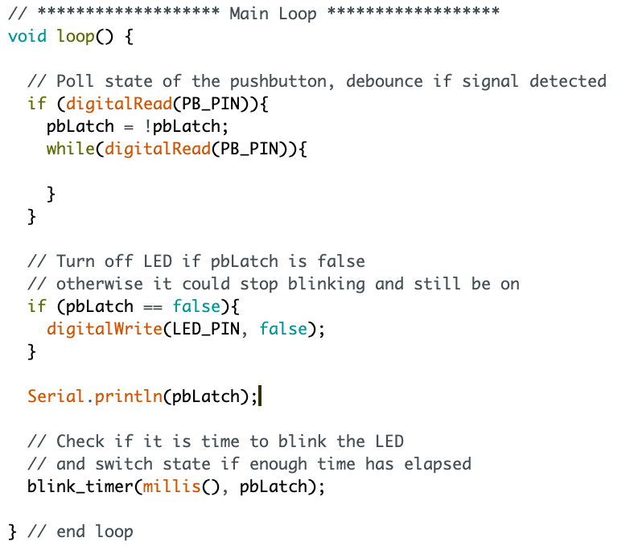
Polling
Poll state of PB_PIN
and switch latch
State.
blink_timer now takes
two variables

Slide 14
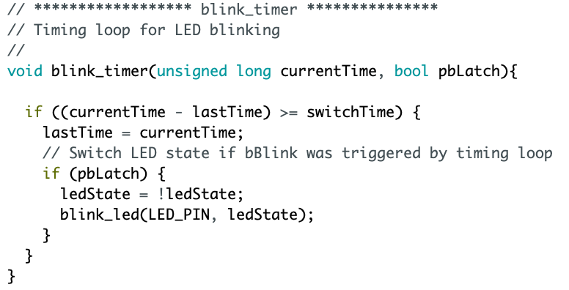
blink_timer - Refactored
Local Boolean
Name does not need to
match with main loop
New if statement

Slide 15
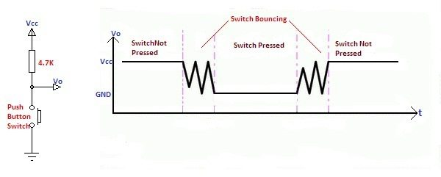
Button Bounce

Slide 16
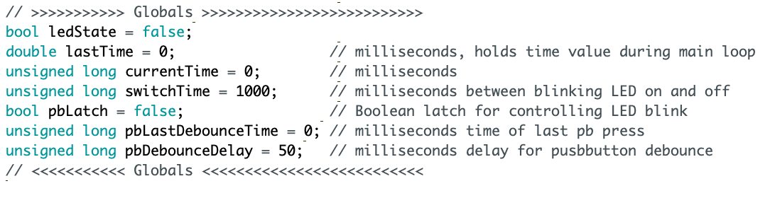
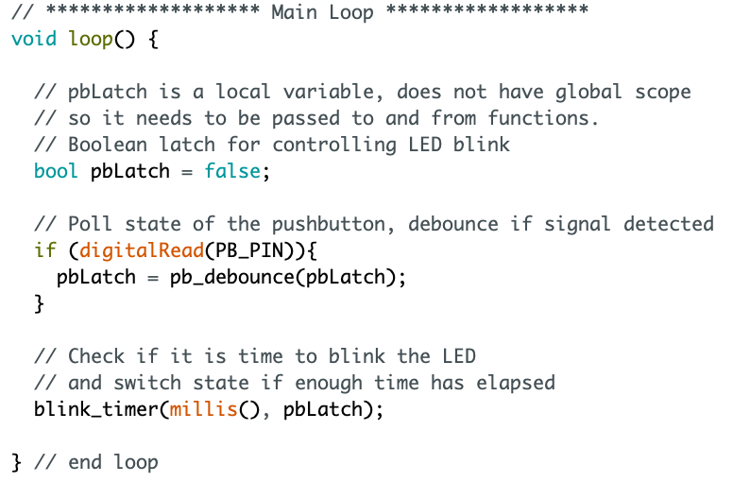
Arduino - Debounce

Slide 17
Activity 7 – Blink_3090 – Debounce
Using
pbLastDebounceTime
pbDebounceDelay
digitalRead()
Millis()
Create
pb_debounce function
Now with Pushbutton Action!!!!

Slide 18
Program Flowchart Debounce
Loop
pbLatch = false
Begin
N
If
Y
Pb_debounce()
Pin Definitions
Pushbutton pressed
If
pbLatch = true
Setup
Pushbutton is
Still pressed
Blink_timer()
N
If
Y
blink_led()
Elapsed Time > Switch Time
&& pbLatch == true

Slide 19
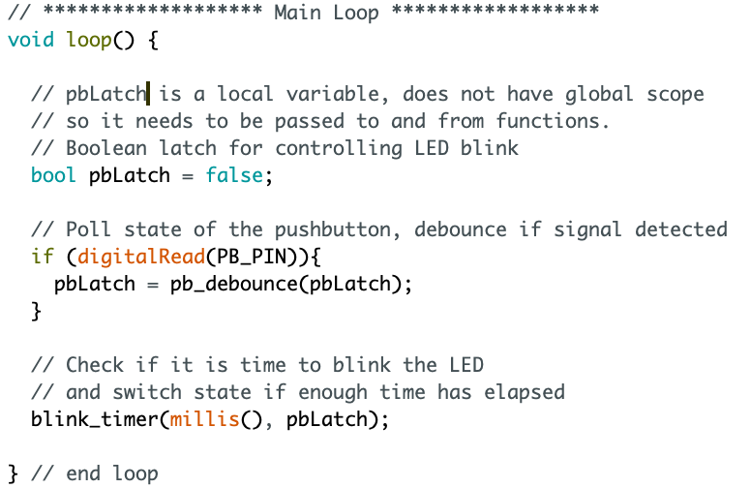
Polling with Debounce
New Function Here
To debounce button

Slide 20
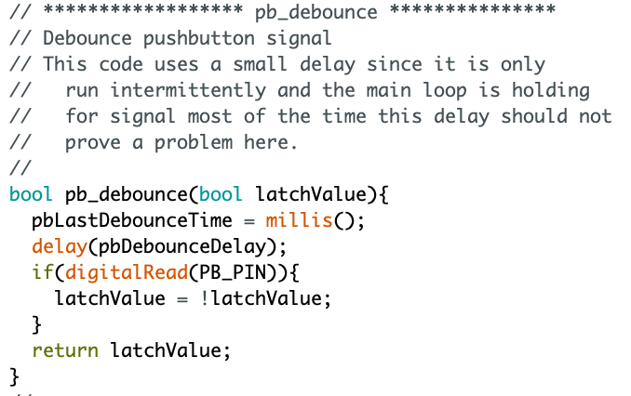
Debounce Code
Return variable type
Very small delay
If button still pressed after delay, latch PB
Return variable

Slide 21
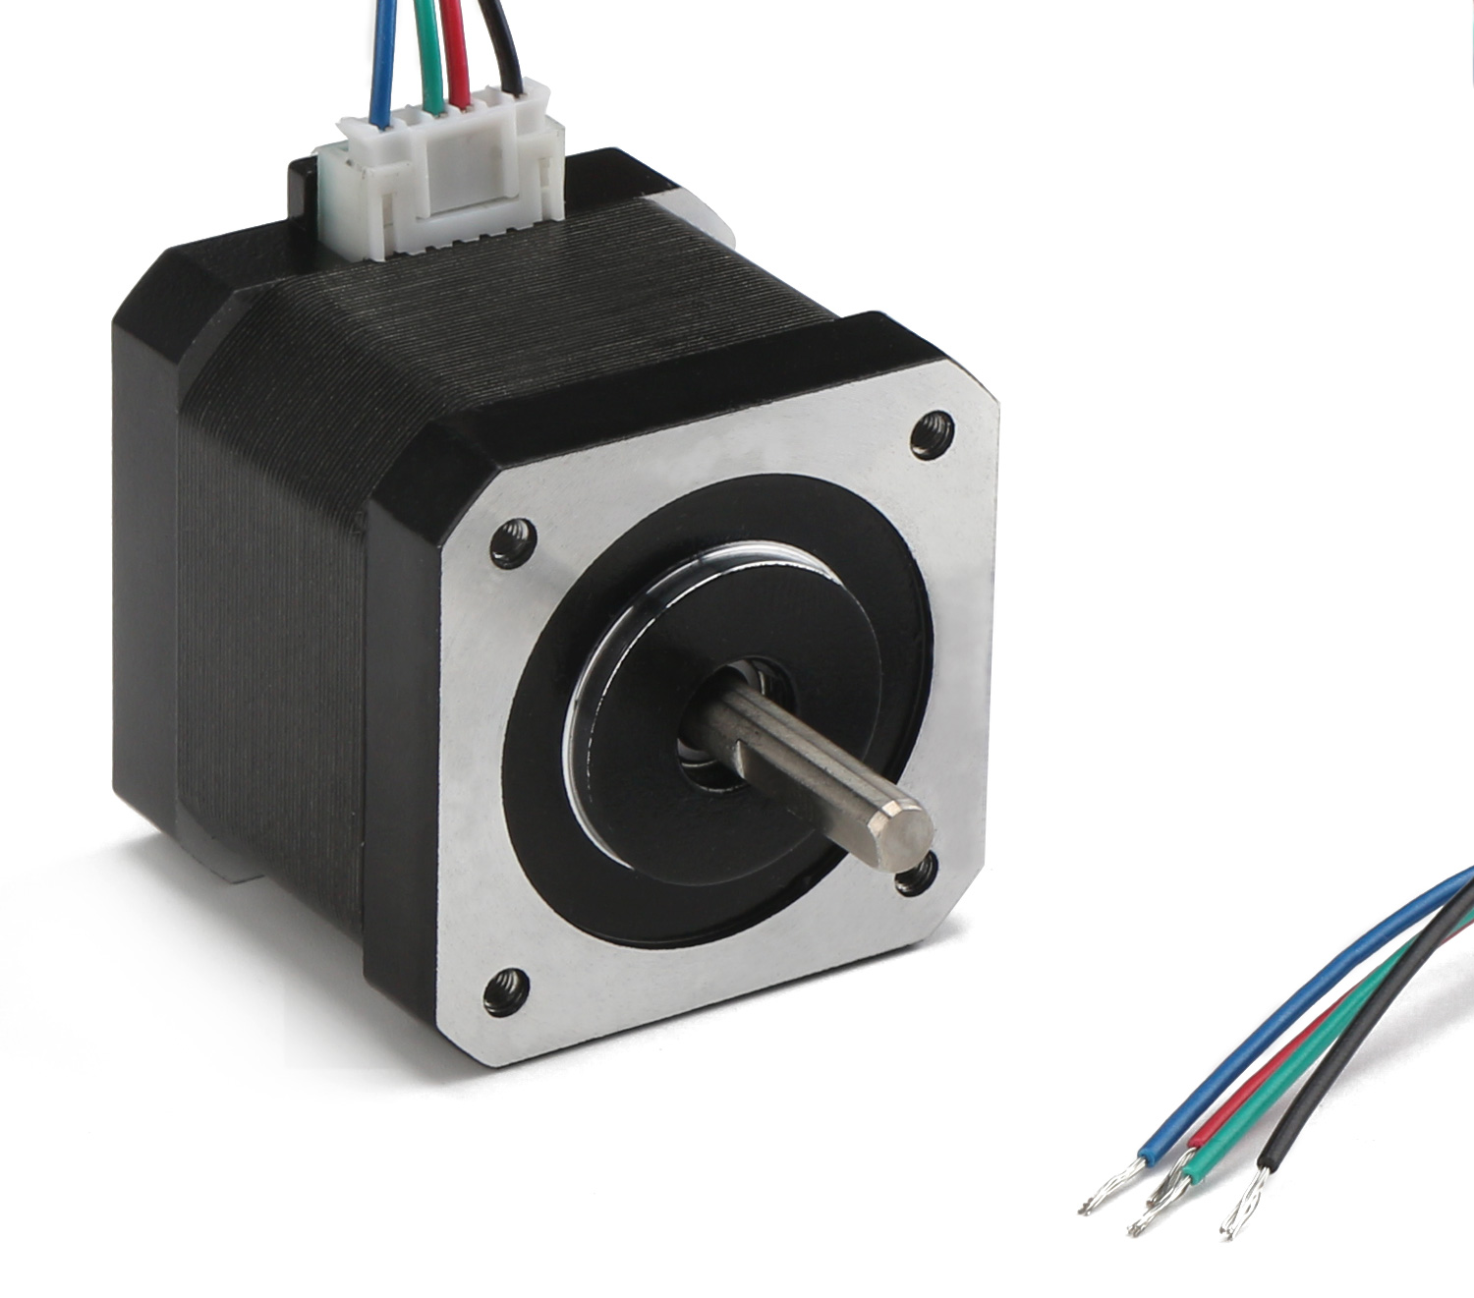
Stepper Motors
Brushless DC motor
200 positions / rotation
1.8 degrees
High torque
Low speed
Accurate rotational positioning
Needs to be indexed

Slide 22
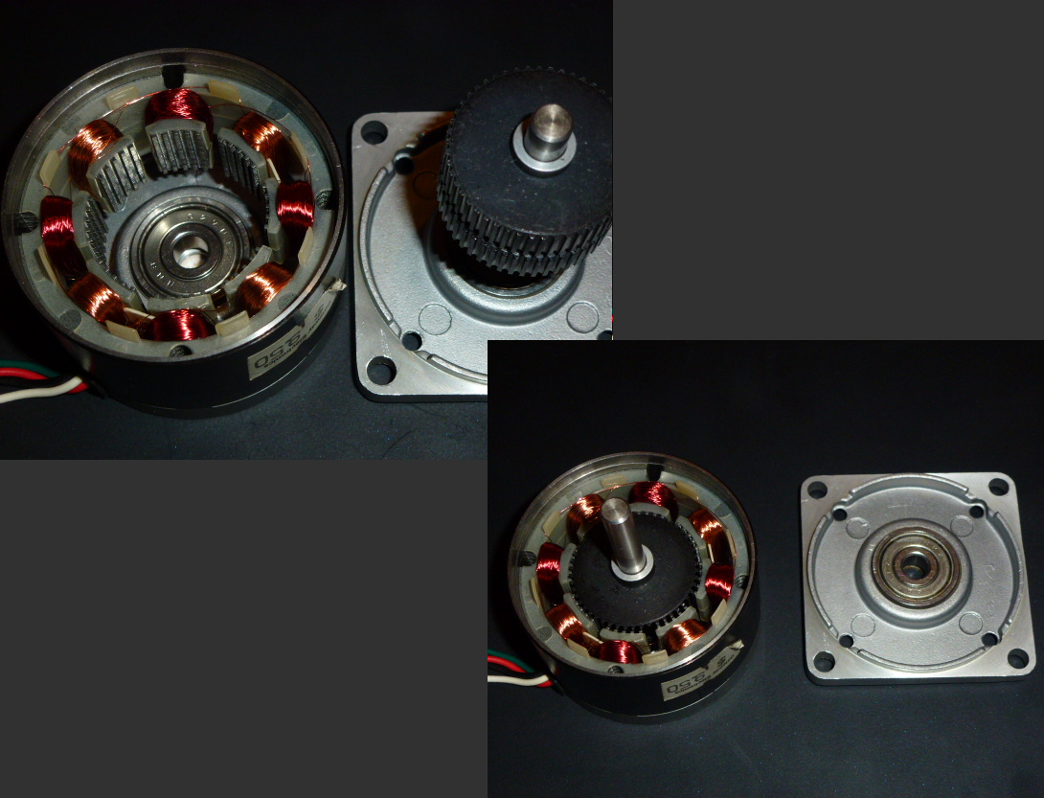
Stepper Motors
4-Wire
Basic Bi-polar stepper
6-Wire
Unipolar Stepper
High Torque
Low Speeds

Slide 23
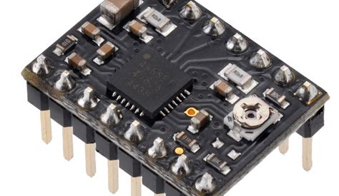
Stepper Motor Drivers
Forward / Reverse
Dir Pin
1-step / low – high signal
Step Pin
Microstepping
MS1
MS2
MS3
12 V Motor Supply
VOMT
Enabled Low
Enable (bar)

Slide 24
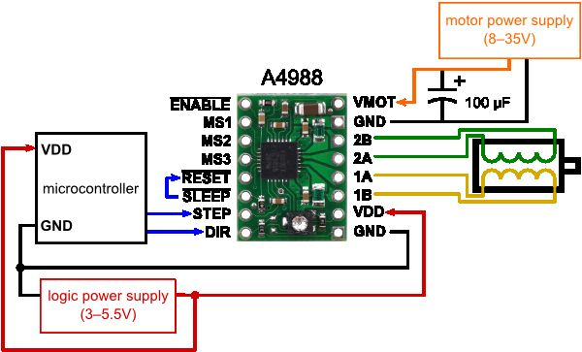
Stepper Motor Driver Wiring
Keep 12V separate from 5V & Arduino pins!
GND
Jumpered
Polarity Matters
Arduino
Header
Wiring different here.

Slide 25
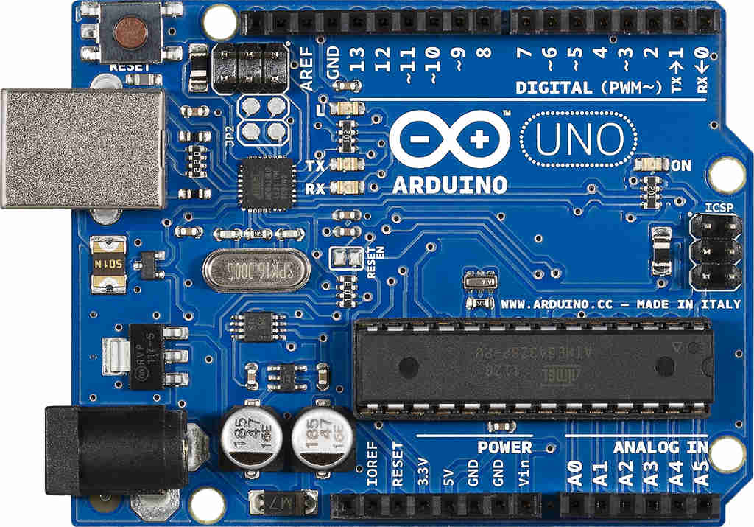
5V Power Wiring
USB to Computer
To Breadboard and Stepper Driver
GND
5V

Slide 26
Activity 8 – Stepper Motor - Wiring
Using
Provided parts
Stepper Motor Driver Wiring Diagram
Create
Stepper motor and driver on breadboard with Arduino LED
Motor Action!!!!

Slide 27
Program Flowchart Run Stepper
Loop
pbLatch = false
Begin
N
If
Y
Pb_debounce()
Pin Definitions
Pushbutton pressed
If
pbLatch = true
Setup
Pushbutton is
Still pressed
Blink_timer()
N
If
Y
blink_led()
Elapsed Time > Switch Time
&& pbLatch == true
run_stepper()

Slide 28
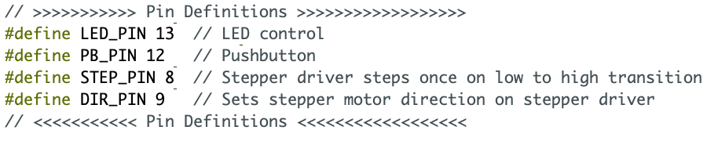
Stepper Pins

Slide 29
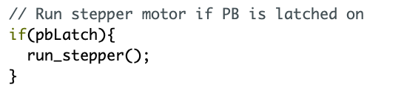
In Main Loop

Slide 30
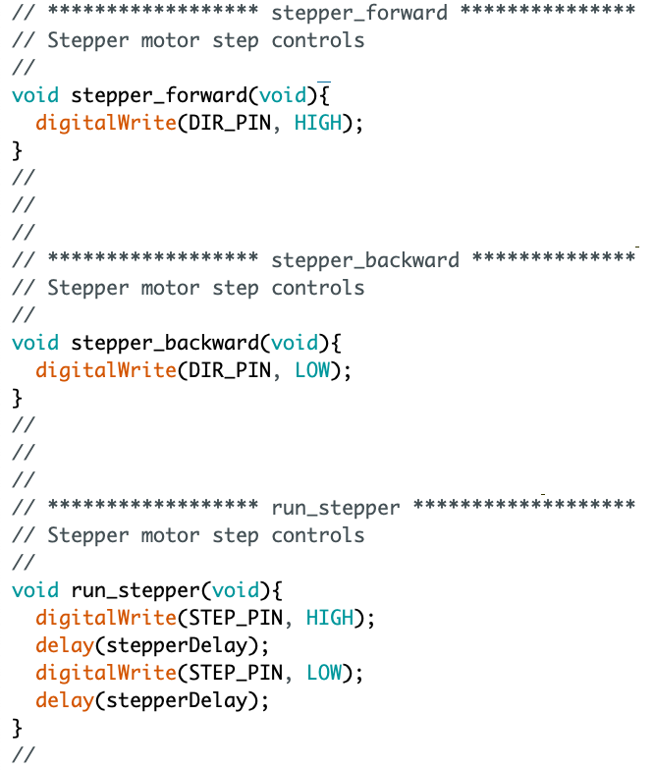
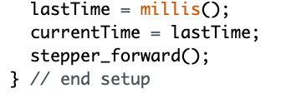
Functions - Stepping
In Setup

Slide 31
Activity 9 – Stepper Motor Programming
Using
STEP_PIN
DIR_PIN
Create
Stepper_forward()
Stepper_backward()
Run_stepper()
Motor Action!!!!

Slide 32
ISR timer is a better way
Interrupt
Service
Routine
Hijack Timer1 on Microcontroller
We are not going to do this…

Slide 33
Project Pump

Slide 34
In-Class
Translate User Story into User Needs
Translate User Needs into Requirements
Build Design Output matrix based on Requirements
Verification Matrix
Validation Matrix

Slide 35
Verification
Validation

Slide 36
Verification - The evaluation of whether or not a product, service, or system complies with a regulation, requirement, specification, or imposed condition. It is often an internal process.
Validation - The assurance that a product, service, or system meets the needs of the customer and other identified stakeholders. It often involves acceptance and suitability with external customers.
https://en.wikipedia.org/wiki/Verification_and_validation

